Slide 1
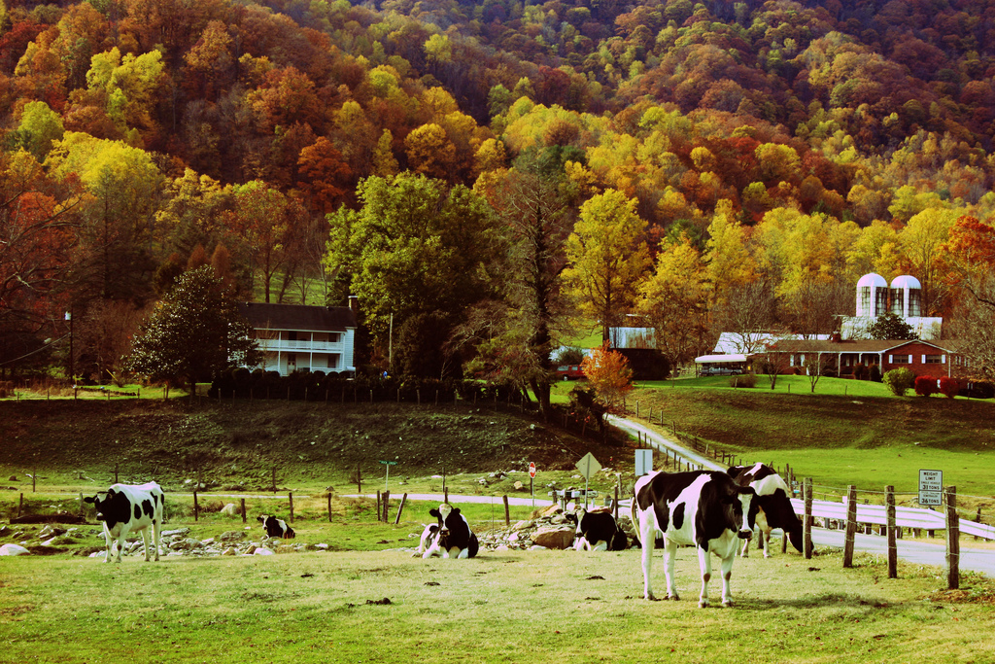
Blue Ridge Women in Agriculture
Grant Writing Workshop
Willa Mays November 19, 2013

Slide 2
Blue Ridge Women in Agriculture
Grant writing workshop
Anyone can write a grant - so relax
However, there are ways to improve your chances
Follow rules EXACTLY-
Read entire request for proposal with a highlighter
If not provided make a Checklist of required items
Review, review, review
Write for the READER
Understand their aspirations
Frame your project accordingly
Read with fresh eyes -many times

Slide 3
General Tips & considerations
Always scanning for opportunities to meet and interact with granting agencies- network
Relationships do matter- start building them
Tell a story- but not a sob story-
Proposal should “flow” like a story- some personal information is ok-it can set you apart (previous achievements)
Understand your subject matter
People who review grants are typically experts- demonstrate that you know what you are doing
What makes you unique? What makes you stand out from the crowd? Experience? Special opportunity?

Slide 4
Example of writing for Reader
“Please give me money to start a duck egg business that will provide me more income.”
Demonstrating that duck eggs can be a viable business venture for regional farmers, this project will result in an overall increase in domestic and wild waterfowl habitat and protect water quality by encouraging low impact use for ponds and streams.
Make it easy for them to give you money. Frame your project in their stated goals.

Slide 5
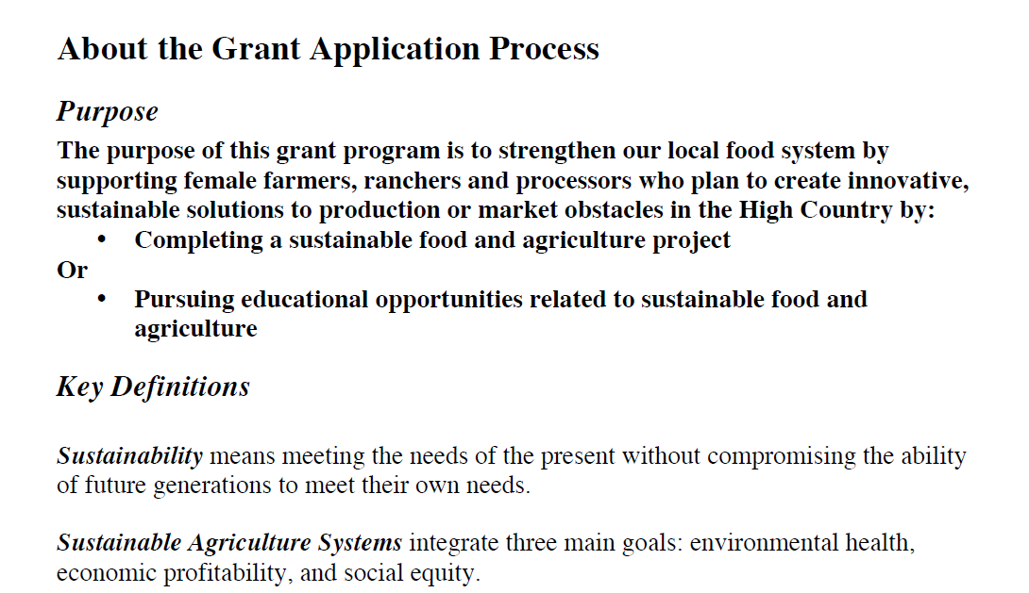
Most RFPs will state their goals clearly: as is the case with the Mary Boyer Sustainable Food & Ag

Slide 6
General Proposal Outline-in order of writing when no outline provided
Needs statement: setting the stage- Be as specific as possible- use statistics to make your case
There is no existing market for my duck-eggs
While there is a vibrant market in the neighboring counties of Ashe, Avery, and Caldwell with 15 restaurants serving duck eggs, there are currently only 2 restaurants in Watauga County with Duck-egg omelets on the menu.
Project Description (solution): How does your project respond to the need you have outlined above?
What are your specific goals?
Your ability to implement successfully- success breeds success
Describe Success (evaluation)- what results will you achieve and how you will measure success of the project? (Use numbers- 3 new restaurants first year). Then relate to bigger picture in needs statement- benefit to community beyond your success.

Slide 7
General Proposal Outline- in order of writing
Longterm implications (Sustainability): How the investment the funder makes will generate a good ROI (return on investment). Will this project contribute over time?
Budget
Budgets are guidelines: your best estimate of the realistic cost/benefit of project
Be as specific as you can- research
Be Accurate- make sure all income and expenses add up
Executive Summary – concise summary of key points of entire proposal
Cover Letter- use to connect with reader- your chance to be creative and give some personal insight- express your personality
Contact information- don’t forget!
Be who you are but be professional

Slide 8
Specific Opportunities
BRWIA-
WNCAg
Review RFP Handouts- and use specific examples

